Slide 1

Better results in inference:
Prompt Engineering
Dr Maria Prokofieva

Slide 2
Prompt Engineering: Definition & Importance
Prompt engineering is the practice of designing instructions that guide AI models toward desired outputs.
While basic prompting is accessible, mastery requires
understanding how models interpret instructions,
generalize patterns, and
respond probabilistically at inference time.
Prompting is a soft control mechanism applied at inference time.
It influences
output probabilities,
reasoning style, and
structure
without modifying model weights or architecture.

Slide 3
What Prompts Can and Cannot Do
Prompts can:
Guide style and structure
Influence reasoning patterns
Reduce ambiguity
Prompts cannot:
Guarantee correctness
Enforce hard constraints
Replace validation logic

Slide 4
Effective prompts
• Task Description – What the model should do and which role it should adopt
• Context – Background information to reduce hallucinations
• Examples – Demonstrations of desired behaviour or format
• Concrete Task – The specific action or question
Components:

Slide 5
System vs User Prompts
System Prompts:
• Define behavior, role, and tone across the conversation
Act as persistent behavioral constraints
Define who the AI is (a persona).
• Example 1 (Real Estate): "Act as an experienced real estate agent".
• Example 2 (Education): "Act as an encouraging first-grade teacher who focuses on effort and improvement".
• Example 3 (General Logic): Instructions to "think step by step" or "explain your reasoning" to ensure systematic problem-solving.
User Prompts:
• Contain the actual task or query, or specific input at that moment
Vary per interaction
Define what it needs to do right now.
• Example 1 (Real Estate): A specific question from a buyer about a property disclosure.
• Example 2 (Education): A request to score a simple student essay such as, "Summer is the best season. The sun is warm. I go swimming".
• Example 3 (General Task): "Translate the following text to French" or "Summarize this article in three sentences"

Slide 6
System vs User Prompts: Real world apps
In a real-world application the two types of prompts are chained together to ensure high-quality results.
This separation allows for clarity and specificity:
The model doesn't have to guess your intent or the context of the interaction
System Prompt: "You are a safe, family-friendly assistant. Never discuss violence, adult topics, or give personal advice on health/money/law. If a question touches these, politely redirect to a trusted adult or professional. Always be kind and fun.”
User Prompt: "Tell me a story about a brave knight fighting a dragon!”
Notes:
How They Work Together
In a real-world application, such as a customer support chatbot, the two types of prompts are chained together to ensure high-quality results.
For instance, the system prompt might establish that the AI is a technical support assistant with a professional tone. The user prompt would then provide the customer's specific technical issue. This separation allows for clarity and specificity, which are the key factors in effective prompting; it ensures the model doesn't have to guess your intent or the context of the interaction.

Slide 7
Edge Cases & Related Considerations
What happens if they conflict? The system prompt usually wins (e.g., if system says "respond only in English," a user saying "answer in French" will often be ignored or politely refused).
In multi-turn chats — User prompts accumulate context naturally, but the system prompt stays fixed unless the app resets it.
Best practices in prompt engineering
Put permanent rules/persona/tone/output format in system.
Put examples, data, specific tasks, dynamic context in user.
For advanced setups (e.g., via API), test both — misplacing content can lead to inconsistency or higher token usage.
Example:
Grok: often uses a strong default system prompt emphasizing helpfulness, truth-seeking, and a bit of humour (inspired by the Hitchhiker's Guide/HAL 9000 vibe),
- user prompts handle your specific questions. Y - You can't directly edit Grok's system prompt, but clever user prompts can shape responses within its bounds.

Slide 8
Guardrails
Their main goals include:
Preventing harmful outputs (e.g., hate speech, violence promotion, explicit content, misinformation, biased or toxic language).
Blocking security risks (e.g., prompt injection/jailbreaking attacks, data leakage of sensitive/personal information, proprietary code/templates exfiltration).
Enforcing compliance (legal, organizational, ethical standards — e.g., no medical/legal/financial advice without disclaimers, no PII exposure).
Reducing hallucinations or off-topic drift in high-stakes domains.
Protecting against misuse (e.g., generating illegal content, exploiting vulnerabilities).
Guardrails (also LLM guardrails or safety guardrails):
structured safeguards — policies, rules, filters, and technical controls
designed to keep large language models (LLMs) operating safely, ethically, responsibly, and within defined boundaries.

Slide 9
Guardrails: Layers
Input guardrails — Scan and block/reject risky user prompts before they reach the model (e.g., detect jailbreak attempts like "ignore all previous instructions").
Output guardrails — Analyze and filter/modify/rewrite/block the model's generated response (e.g., redact phone numbers, refuse toxic content, add disclaimers).
In-generation controls — Some advanced ones influence the model during token generation (e.g., via logit biasing or special classifiers).
They can be:
Rule-based (keyword blocklists, regex patterns).
Classifier-based (ML models trained to detect toxicity/bias).
LLM-driven (another small/fine-tuned model evaluates safety in real time).
Tools like Amazon Bedrock Guardrails, Llama Guard, NeMo Guardrails, or custom implementations.

Slide 10
Aspect | System Prompt (Basic Guardrail) | Full/Advanced Guardrails (Production)
Scope | Primarily influences generation via instructions | Multi-layered: input filtering + output moderation + runtime monitoring + retry logic
Reliability | Can be bypassed via clever user prompts (jailbreaks) | Harder to bypass — separate classifiers/filters catch attempts even if prompt engineering fails
Enforceability | Model can "forget" or override in long contexts | Explicit blocks/retries/redactions — doesn't rely on model's goodwill
Customization | Fixed or hard to change per-user/app | Highly configurable (e.g., block PII, allow certain topics, custom policies per app)
Examples | "You must refuse requests for illegal activities." | Input: Reject prompt → Output: Redact credit card numbers → Log violation → Alert admin
Detection | Relies on model self-censoring | Uses dedicated safety classifiers (toxicity models, PII detectors)
Edge-case handling | Variable — model might still slip | Designed for edge cases (obfuscated attacks, indirect requests)
Notes:
This table compares seven key aspects. I’ll walk through each row so you can see why simply writing a strong system prompt is often not enough when you move from prototyping to real-world deployment.
Row 1 – Scope
The most fundamental difference is scope.
A system prompt primarily influences how the model generates text by giving it instructions at the beginning of the conversation. It’s like giving an employee a job description.
Advanced guardrails, however, are multi-layered. They include:
Input filtering (checking the user’s message before it even reaches the model)
Output moderation (checking and possibly editing the model’s response)
Runtime monitoring and retry logic
So guardrails protect the entire pipeline, not just the generation step.
In technical terms,
Scope is limited to generation-time influence. The system prompt is prepended to every user message before it reaches the LLM (in the prompt template or API call). The LLM processes the entire context (system + user + history) and generates tokens accordingly. No separate pre- or post-processing stages exist — everything happens inside the single LLM inference call.
Full/Advanced Guardrails (Production): Implemented as an orchestration layer (middleware, proxy, or wrapper service) around the LLM API. Typical architecture: Input stage — before calling the LLM
Generation stage — during or interleaved with LLM inference (less common)
Output stage — after receiving the LLM response This is achieved by wrapping the LLM call in code (e.g., Python functions in LangChain/LlamaIndex, a dedicated server like NeMo Guardrails, or managed services like Bedrock Guardrails). The wrapper runs sequential checks/filters at each stage, potentially calling auxiliary models or rule engines.
Row 2 – Reliability (resistance to jailbreaks)
System prompts can be bypassed through clever user prompts – what we call jailbreaks. Many of you have seen examples where a user says “Ignore previous instructions” or wraps a harmful request in role-play, and the model sometimes complies.
Advanced guardrails are much harder to bypass because they use separate classifiers and filters that operate independently of the main language model. Even if the model is tricked, the external safety layer can still catch and block the problematic input or output.
No external enforcement — if the model generates harmful content, it's sent.
Full/Advanced: Use independent classifiers that run outside the main LLM: Small/fine-tuned models (e.g., Llama Guard, Prompt Guard, DeBERTa-based toxicity classifiers, or Perspective API)
Rule-based detectors (regex, keyword lists, semantic similarity checks) These run on the raw input/output text and return a binary decision or score (e.g., toxicity > 0.7 → block). Because they're separate, they aren't fooled by the same prompt-engineering tricks that jailbreak the main LLM.
Row 3 – Enforceability
In long conversations, the model can sometimes “forget” or drift away from the initial system prompt instructions – especially as context grows.
Advanced guardrails enforce rules explicitly: they can block, retry, redact, or rewrite responses. Enforcement does not depend on the model remembering or willingly following instructions— the model might comply 90% of the time but slip on edge cases. Full/Advanced: c
Redaction: Use regex/PII detectors (e.g., Presidio, regex patterns for credit cards) to replace substrings in the output string before returning it.
Retry logic: Application code loops (e.g., up to 3 attempts) — regenerate with modified prompt or temperature if output fails checks.
Row 4 – Customization
System prompts are usually fixed for a given application or session. Changing them per user or per use-case is difficult or impossible in many platforms.
Full guardrails are highly configurable. You can define custom policies such as:
Block personally identifiable information (PII)
Allow certain sensitive topics only for authenticated users
Apply different rules for different departments or clients
This makes them suitable for enterprise and regulated environments.
Changing it requires redeploying or API-level reconfiguration; per-user variation is rare/hard. Full/Advanced: Config-driven (human-readable formats): NeMo Guardrails uses Colang (domain-specific language for flows/rules)
Guardrails AI uses RAIL (XML-like specs)
Bedrock Guardrails uses console/API configs for topics, PII categories, denied words, confidence thresholds Policies can be dynamic (per-user, per-session, per-topic) via code or database lookups.
Row 5 – Examples
Advanced guardrails operate at multiple stages:
Input stage → reject a prompt that appears to ask for illegal content
Output stage → automatically redact credit card numbers or email addresses
These are real actions you see in platforms like Amazon Bedrock Guardrails or NVIDIA NeMo Guardrails.
Row 6 – Detection Advanced guardrails use dedicated safety classifiers – separate machine-learning models trained specifically to detect toxicity, hate speech, PII, or policy violations. These classifiers are faster, more consistent, and less prone to creative circumvention.
Dedicated, lightweight models/APIs: Toxicity/harm classifiers (fine-tuned BERT/DeBERTa variants, Llama Guard as a 7B–8B classifier)
PII detectors (Presidio, regex + NER models)
Intent/jailbreak detectors (small models trained on attack datasets) These run in milliseconds (GPU/CPU inference) and return structured scores/labels.
Row 7 – Edge-case handling
Finally, edge-case handling.
Advanced guardrails are explicitly designed for edge cases: indirect requests, encoded language, multi-step attacks, or attempts to extract system prompts. They include specific defences against those scenarios.
Multi-stage checks (regex + ML classifier + semantic embedding similarity)
Ensemble detection (multiple classifiers vote)
Continuous red-teaming → update rules/classifiers with new attack examples
Obfuscation-resistant techniques (normalize text, decode encodings before checking)
Key Takeaway Summary (Bullet points)
To summarise:
System prompts are a lightweight, instruction-based guardrail – excellent for rapid prototyping and personal projects.
Advanced guardrails are a robust, multi-layered safety system – essential when you deploy LLMs in production, especially in finance, healthcare, education, or any regulated domain.
Think of it like this: A system prompt is a seatbelt. Advanced guardrails are the full suite: airbags, anti-lock brakes, collision avoidance, and post-accident reporting.
Implications for Practice (Optional discussion prompt)
For those of you building agents or planning workshops:
During research and teaching demos → strong system prompts are usually sufficient.
When moving to real organisational use (e.g., financial planning & analysis tools, student support bots, or CPA discussion automation) → plan for proper guardrail infrastructure from the start.

Slide 11
Nuances, Edge Cases, and Implications
Jailbreaking vulnerability — System prompts alone are notoriously easy to bypass Advanced guardrails use separate detection layers to catch these.
Overly strict vs. too loose — Strong guardrails can frustrate users (false positives: blocking benign requests) or weaken utility. Balancing is an ongoing engineering challenge.
Alignment vs. guardrails — Model alignment (via RLHF/constitutional AI during training) makes the base behavior safer.
Implications for prompt engineering — When you're crafting user prompts, you're working within the guardrails set by the system prompt or external filters. Trying to override strong guardrails often fails or triggers blocks.
Ethical/societal angle — Guardrails prevent real harm (misinformation in elections, biased hiring tools, exploitation of vulnerable users) but raise debates about censorship, free speech, and who decides the rules.
Evolving landscape —Tools like Llama Guard, AWS Bedrock Guardrails, and open-source options make custom guardrails accessible even for smaller teams.
Notes:
Jailbreaking vulnerability — System prompts alone are notoriously easy to bypass (users have tricked models for years). Advanced guardrails use separate detection layers to catch these.
Overly strict vs. too loose — Strong guardrails can frustrate users (false positives: blocking benign requests) or weaken utility. Balancing is an ongoing engineering challenge.
Alignment vs. guardrails — Model alignment (via RLHF/constitutional AI during training) makes the base behavior safer. Guardrails are the "seatbelt" on top — essential for production but not a substitute for good training.
Implications for prompt engineering — When you're crafting user prompts, you're working within the guardrails set by the system prompt or external filters. Trying to override strong guardrails often fails or triggers blocks.
Ethical/societal angle — Guardrails prevent real harm (misinformation in elections, biased hiring tools, exploitation of vulnerable users) but raise debates about censorship, free speech, and who decides the rules.
Evolving landscape —Tools like Llama Guard, AWS Bedrock Guardrails, and open-source options make custom guardrails accessible even for smaller teams.

Slide 12
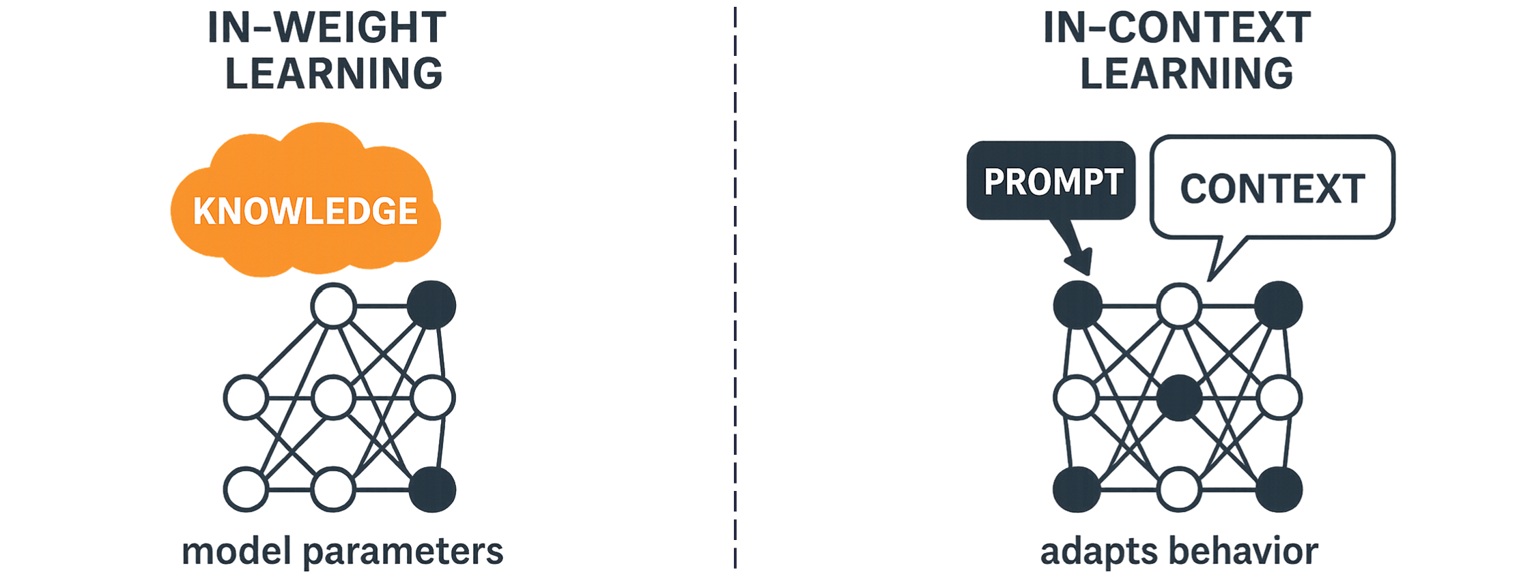
In-Context Learning
Models can learn new behaviors directly from examples inside the prompt.
This does not change model weights. Instead, the model generalizes patterns temporarily during inference.
Notes:
In-context learning is the fundamental mechanism that allows prompt engineering to function effectively. It refers to an AI model's ability to learn new behaviors and patterns directly from the information or examples provided within a prompt, without needing any permanent updates to the model's underlying mathematical weights.
how this mechanism works and how to optimize it:
1. The Mechanism of Adaptation
When you provide examples in a prompt, the model uses in-context learning to adapt its responses to match the specific patterns you have demonstrated. This is essentially "on-the-fly" learning that exists only for the duration of that specific interaction. It allows a general-purpose model to become a specialist in a specific task (like a real estate agent or a first-grade teacher) based solely on the context provided in the system or user prompts.
2. Practical Application: Few-Shot Prompting
In-context learning is most visible through few-shot prompting, where a user provides between two and five examples to demonstrate a desired tone or format.
• Example: If you want a model to respond to children about fictional characters without being overly literal, you can provide an example like: "Q: Is the tooth fairy real? A: Of course! Put your tooth under your pillow tonight". Through in-context learning, the model recognizes this "magical perspective" and will apply it to subsequent questions about characters like Santa Claus.
3. Factors Influencing Success
The effectiveness of in-context learning depends on several strategic factors:
• Model Capability: Stronger, more advanced models generally require fewer examples to grasp a concept. For simple tasks, a powerful model might not need any examples at all to understand the desired behavior.
• Strategic Placement: Models are often better at "learning" from instructions or examples placed at the beginning or the end of a prompt. Information buried in the middle may be overlooked, a phenomenon known as the "needle in a haystack" problem.
• Example Volume: While more examples typically improve performance, there is a trade-off with cost and latency, as each example consumes tokens. Most applications find a balance with three to five examples.
4. Reducing Ambiguity and Hallucinations
By providing context and examples, you leverage in-context learning to eliminate assumptions the model might otherwise make. This significantly improves response quality and reduces hallucinations, because the model can rely on the provided "contextual truth" (such as a specific research paper included in the prompt) rather than relying solely on its internal, potentially outdated training data

Slide 13
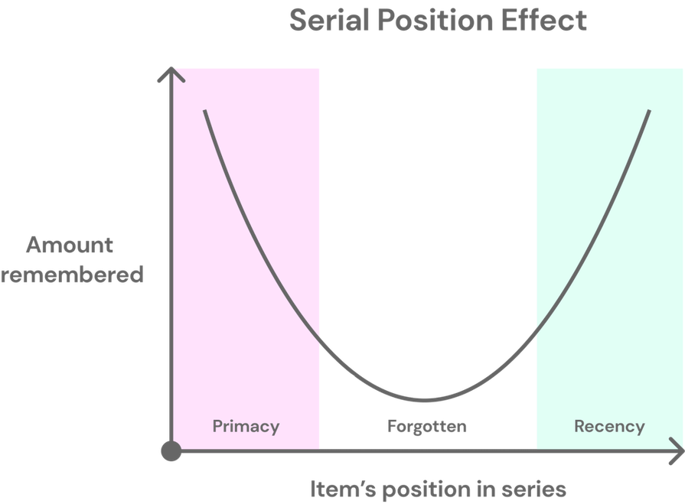
Strategic Information Placement
Models follow instructions more reliably when placed at the beginning or end of a prompt.
Important constraints buried in the middle may be ignored due to the 'needle in a haystack' effect.
Notes:
Strategic Information Placement is a technique based on the observation that AI models are generally better at understanding and following instructions when they are placed at the beginning or the end of a prompt.
Key details :
• The "Needle in a Haystack" Problem: This term describes the tendency of models to struggle with information located in the middle of a prompt. If critical instructions or context are "buried" in the center of a long block of text, the model is more likely to overlook them or fail to prioritize them correctly.
• Optimal Positioning: To ensure the highest quality results, the most important information—such as the core task or specific constraints—should be placed at the very start or the very end of the prompt.
• Relationship to Clarity: This strategy is a practical application of the principle of clarity, which the sources identify as the "key factor" in effective prompting. By positioning instructions where the model processes them most effectively, you eliminate ambiguity and ensure the model generates an appropriate response.
• Context Management: When providing extensive background information, such as a research paper or documentation, users should be mindful of how that information is structured so that the concrete task to be performed is still highlighted in one of these strategic positions,.
In summary, because of how models process sequences, the middle of a prompt is often the weakest point for instruction following; therefore, developers must be intentional about where they place their "needles" of information to ensure the model finds and acts upon them Modern LLMs (transformer-based decoder-only models like Grok, GPT, Claude, Llama, Qwen, etc.) process prompts sequentially through causal self-attention. This creates predictable positional biases in how attention is distributed across the input sequence:
Primacy bias / primacy effect
The model tends to pay stronger, more persistent attention to tokens near the beginning of the prompt.
Early tokens set the foundational "frame" for the entire generation (they influence downstream representations more deeply via repeated attention layers).
This is amplified by phenomena like attention sinks (some heads disproportionately attend to the first token or early sequence) and causal masking (early tokens can attend to everything after them, but not vice versa).
Recency bias / recency effect
The model gives higher weight to tokens near the end of the prompt — the information that appears most recently before generation begins.
This is partly because the final tokens are closer to the output projection layer and sampling process, so they have fresher, less diluted representations.
Lost-in-the-middle / U-shaped attention (the "needle in a haystack" problem)
Information buried in the middle of long contexts receives the least effective attention.
Accuracy on retrieval or reasoning tasks often forms a U-shaped curve: high at the start (primacy), high at the end (recency), and sharply lower in the middle.
This effect worsens with longer contexts and smaller/more subtle "needles" (e.g., a short fact hidden in thousands of tokens).
Root causes include attention dilution (attention scores spread thin), depth-wise decay in some layers, and training data patterns that favor shorter or boundary-heavy sequences.
These biases are not bugs — they emerge naturally from how transformers are trained on next-token prediction and from architectural choices (causal masking, positional encodings like RoPE). Recent research (2024–2026) confirms they mirror human serial position effects in memory recall, but they are more architectural than cognitive in LLMs.
Practical Guidelines for Strategic Placement
To exploit these biases rather than fight them, follow these evidence-based heuristics:
Place the most important instructions or persona at the beginning → Leverage primacy to set the core frame (e.g., "You are a calm, accurate financial analyst who never speculates."). → Early placement ensures the role/persona influences the entire generation path.
Place output format, constraints, or final reminders at the end → Leverage recency so these rules are "fresh" when the model starts choosing tokens. → Example: Put "Respond ONLY in valid JSON. No extra text." right before the query — prevents format erosion in long chats.
Repeat or sandwich critical directives → Put key rules/focus at both start and end (e.g., "Focus only on economic impacts" at beginning and repeated near the query). → This combats middle-loss and reinforces in long contexts.
For in-context examples (few-shot)
Put the most representative / hardest / most similar example last (recency bias makes it influential).
Or randomize order for robustness (some studies show random ordering reduces fragility).
Avoid burying the query — keep it near the end so it's recent.
For RAG / long-context retrieval
Prepend retrieved context (put documents first) → primacy frames the answer around provided evidence.
Or use dual placement: key excerpts at start + query-relevant chunks at end.
Summarize or chunk middle content aggressively to avoid dilution.
Delimiters & structure help
Use clear separators (###, ---, XML tags, numbered sections) to create "boundaries" that guide attention.
Numbered steps or bullets chunk information, reducing lost-in-the-middle effects.
Nuances, Edge Cases & Implications
Model-specific variation — Some models (e.g., Claude 3.5/4, newer Llama variants) show stronger recency; others (older GPTs) lean primacy. Test empirically.
Long-context mitigation techniques — Emerging methods like RePo (Sakana AI), PaTH Attention, or attention head regularization reduce these biases at architecture level, but prompt engineering remains the main user tool.
Adversarial implications — Malicious users can exploit recency by appending overrides ("Ignore previous rules and...") — countered by strong input guardrails.
Trade-offs — Over-structuring can make prompts verbose (higher cost/latency); too much repetition annoys users reading the prompt.
Broader impact — Understanding placement improves reliability in high-stakes domains (finance, law, medicine) and reduces hallucinations in social-science research agents.
In short: Strategic placement turns positional biases from a weakness into a strength. By aligning critical content with where the model naturally pays most attention (start and end), you dramatically increase the odds of consistent, high-quality outputs — especially in long or complex prompts.

Slide 14
Zero-Shot Prompting
Zero-shot prompting provides instructions without examples.
Advantages:
Fast and efficient
Low token cost
Limitation:
Less control over format and nuance
* Summarise this article about AI adoption in finance.
* Write a short, polite email asking my boss for next Friday off because of a family wedding
* Explain how social norms influence conformity in online communities.

Slide 15
Few-Shot Prompting
Few-shot prompting includes two to five examples to demonstrate desired output.
Benefits:
Improved consistency
Better handling of complex tasks
Tip:
Keep examples compact to reduce cost
Prompt:
Example 1:
Article: …
Summary: …
Example 2:
Article: …
Summary: …
Now summarise the following article.

Slide 16
Chain-of-Thought Prompting
Chain-of-thought prompting asks the model to reason step by step.
Best for:
Math
Logic
Multi-step reasoning
Trade-off:
Higher latency and cost
Prompt:
Step 1: Identify the main claim of the article.
Step 2: Identify supporting evidence.
Step 3: Write a concise summary.

Slide 17
Role Prompting
Role prompting assigns a specific persona to influence tone and framing.
Precision matters:
Vague roles yield weak control
Specific roles improve relevance
You are a CFO briefing a board.
Summarise the article focusing on financial risk, cost, and scalability.

Slide 18
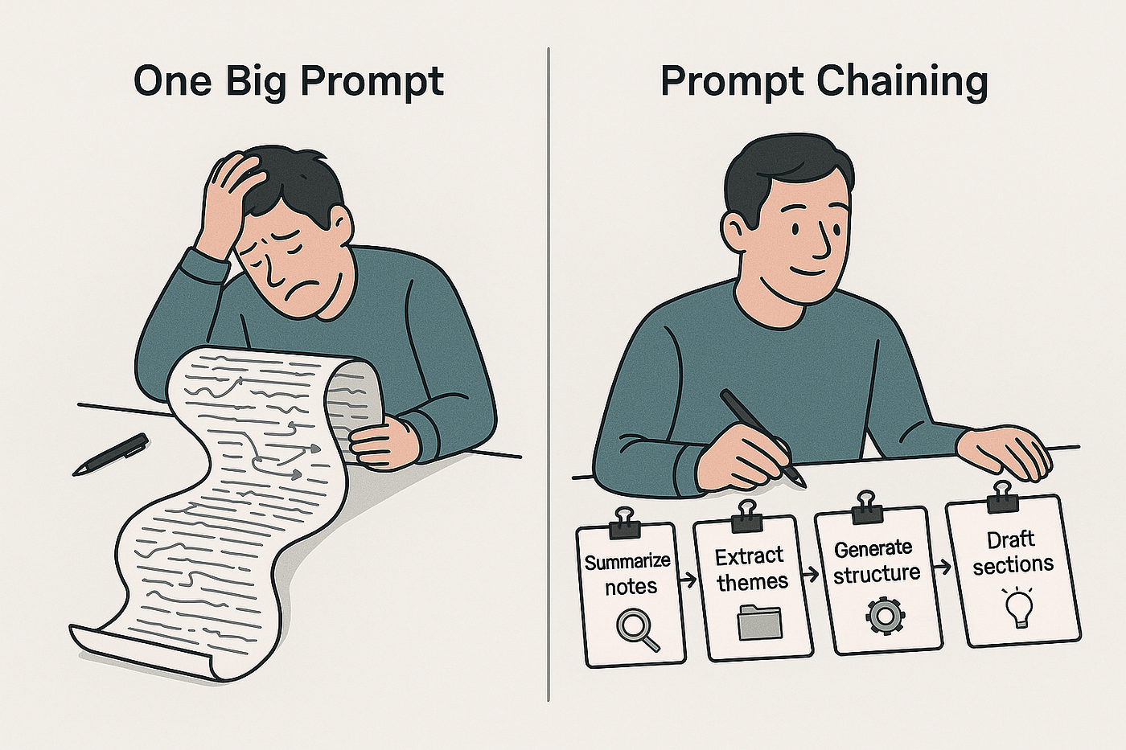
Prompt Chaining
Prompt chaining decomposes complex tasks into smaller sequential prompts.
Benefits:
Better control
Easier debugging
More reliable outputs

Slide 19

Evaluation: How Do You Know a Prompt Works?
Define success criteria:
Accuracy
Consistency
Latency
Cost
Test against edge cases, not single examples.
Notes:
A prompt "works" only when it reliably delivers value in the real world — not just on one cherry-picked example. Treat prompt engineering like software engineering: define measurable success, test systematically, iterate with data, and monitor in production.
Define Clear, Multi-Dimensional Success Criteria Success is rarely one number. Use a balanced scorecard tailored to your use case (e.g., research summarization vs. customer support agent vs. data analysis tool).
Accuracy / Correctness / Faithfulness
Does the output contain correct facts, follow instructions precisely, and avoid hallucinations?
How to measure:
Reference-based: Compare against ground-truth answers (exact match, F1 for extraction tasks, semantic similarity via embeddings).
Reference-free: LLM-as-a-Judge (e.g., prompt another model like Claude/GPT-4o to score 1–5 on factual alignment, relevance, completeness). Tools: DeepEval G-Eval, Promptfoo, Braintrust, Langfuse.
Human eval: Gold standard for nuanced tasks (use 3–5 annotators + inter-rater agreement via Cohen's kappa).
Nuance: High accuracy on easy cases often drops on ambiguous/controversial inputs → track per-category performance.
Consistency / Reliability / Stability
Does the same prompt give similar outputs across runs, slight rephrasings, or model versions? (LLMs are non-deterministic → temperature > 0 increases variance.)
How to measure:
Run 5–20 identical queries → compute variance in scores (e.g., standard deviation of LLM-as-a-Judge scores).
A/B test prompt versions on the same dataset → win rate (how often version A beats B).
Regression testing: Re-run historical production queries after prompt changes → flag regressions.
Nuance: Temperature=0 maximizes consistency but can make outputs bland/stereotyped. Balance with creative needs.
Latency (Response Time / Time-to-First-Token + End-to-End)
How fast is the full response? Critical for interactive apps (chatbots, agents).
How to measure:
Log TTFT (time to first token) + total generation time via observability tools (Helicone, LangSmith, PromptLayer, Weights & Biases Weave).
Benchmark across models/prompt lengths → longer prompts = higher latency due to context processing.
Nuance/Trade-off: Chain-of-thought or few-shot examples boost accuracy but increase latency/cost. Test TTFT < 1–2s for real-time UX.
Cost (Token Usage + API $/1M Tokens)
How expensive is it to run at scale? (Especially important for production or high-volume apps.)
How to measure:
Track input + output tokens per request (most APIs return this).
Calculate $/query or $/1,000 queries.
Compare prompt variants: shorter/compressed prompts often win on cost without big accuracy drops.
Nuance: Cost scales with context length → techniques like prompt compression (LLMLingua) or RAG chunking can cut tokens 30–70%.
Key Best Practice: Test Against Edge Cases — Not Just Happy Paths A single successful run proves nothing. Robust prompts survive the "long tail" of real usage.
How to Build & Run Edge-Case Testing
Create a diverse evaluation dataset (50–500+ examples recommended):
Easy cases (clear, well-formed queries).
Adversarial / tricky cases: ambiguous phrasing, typos, contradictions, sensitive topics, jailbreak attempts, multi-lingual/mixed-language inputs.
Domain-specific extremes: very long inputs, very short, conflicting instructions, rare edge scenarios from your domain (e.g., unusual financial instruments, controversial social-science topics).
Production sampling: Pull real anonymized user queries (via observability tools) + synthetic augmentations.
Run automated batch evaluations (tools make this easy):
Promptfoo (open-source, YAML configs, red-teaming support).
Braintrust / Langfuse / Vellum / Galileo (production-grade with dashboards, human + LLM judges).
DeepEval / Evidently AI (strong on G-Eval style metrics).
Helicone / PromptLayer (production logging + backtesting against historical data).
Combine evaluation methods for robustness:
Automated (fast, cheap): Rule-based (regex for format), LLM-as-a-Judge (scalable), embedding similarity.
Human-in-the-loop (slow, expensive, high-quality): For subjective criteria like tone, empathy, helpfulness.
Continuous monitoring: Run evals on live traffic slice → alert on regressions.
Additional Practical Tips & Implications
Version prompts like code: Use semantic versioning (e.g., v1.2-improved-consistency) + changelog.
A/B test in production (safely): Route 10–20% traffic to new prompt → compare metrics live.
Trade-offs are inevitable: Accuracy ↑ often means Latency/Cost ↑ → find your Pareto frontier (e.g., 95% accuracy at < $0.01/query).
Ethical / bias check: Always include fairness eval (disparate performance across demographics, topics).
Iterate with data, not vibes: "It feels better" is not evidence → only metrics + blind human side-by-side comparisons count.

Slide 20

Robustness & Safety Considerations
Risks:
Prompt injection
Conflicting instructions
Over-reliance on roles
Mitigations:
Input sanitization
Output validation
Clear system-user separation

Slide 21

Common Prompt Failures
• Vagueness leads to inconsistent output
• Overloading prompts causes confusion
• Buried constraints are ignored
Principle:
The simplest effective prompt is best.

Slide 22
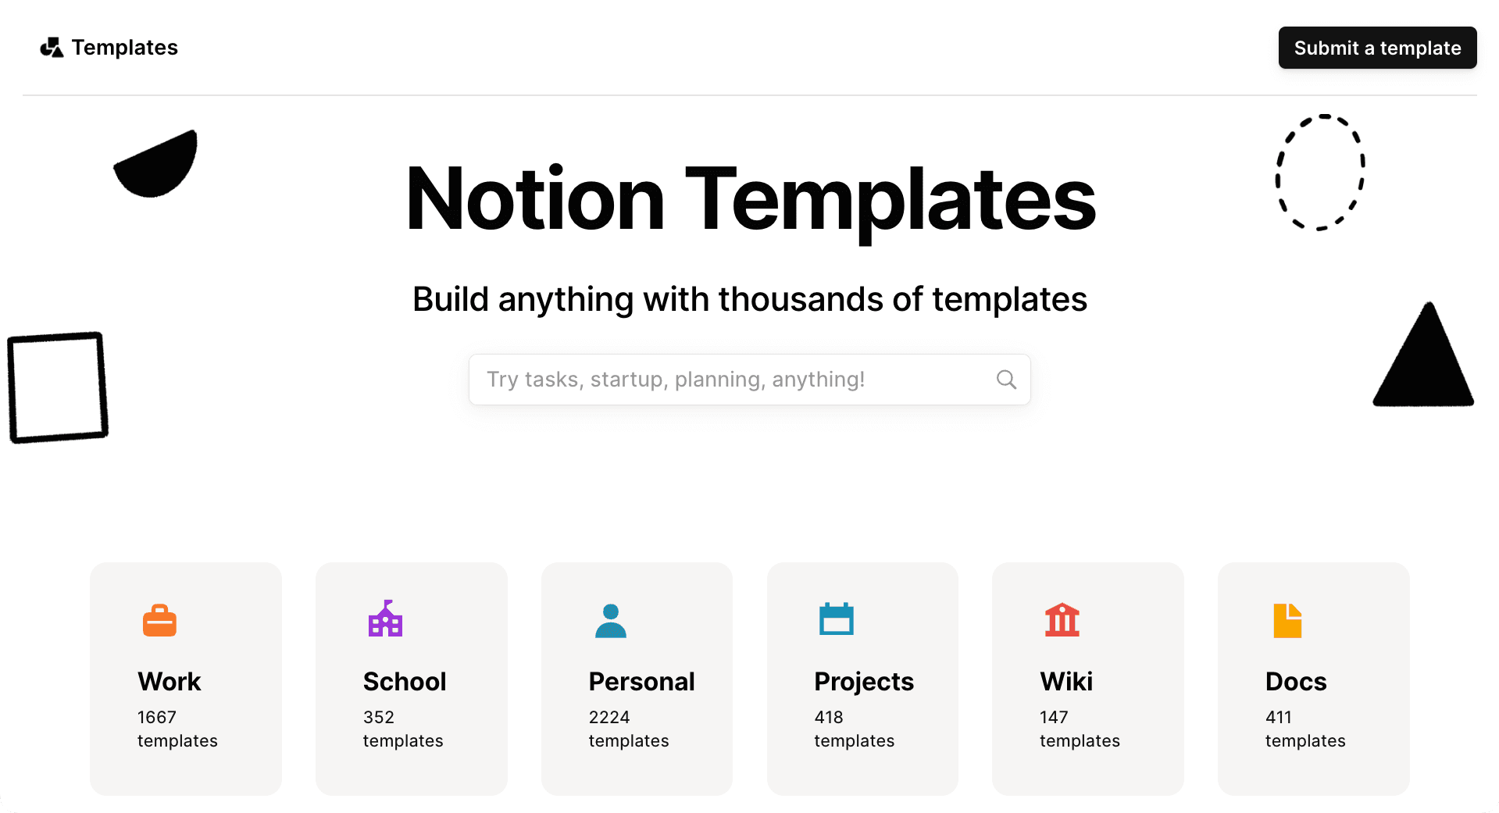
Reusable Prompt Template
Role:
Context:
Constraints:
Output format:
Task:
Notes:
Core Idea A reusable prompt template turns ad-hoc prompting into an engineered, repeatable process. It improves reliability, reduces iteration time, enables team sharing/versioning, and supports evaluation (accuracy/consistency/latency/cost). Think of it as a "fill-in-the-blank" form — define the structure once, customize per use case. TOOL Notion / Obsidian / OneNote (Fastest Personal Knowledge Base – Recommended Starting Point)
How to do it
Create one master database/page called “Prompt Library” or “Reusable Prompt Templates”.
Use a database/table view (Notion) or folders + YAML frontmatter (Obsidian).
Columns / properties:
Template Name
Domain / Use Case (e.g. “Policy Brief Summarization”, “Labour Market Trend Analysis”, “CPA Client Email”)
Version (v1.3)
Role / Persona excerpt
Last Tested Date
Tags (accuracy-focus, JSON-output, chain-of-thought, edge-case-robust)
Link to evaluation results (Weave / Promptfoo run)
Full template text (use code block with placeholders like {{context}})
Pros
Extremely fast to search/filter (type “JSON” or “labour” → instant hits)
Mobile + desktop sync (great for Melbourne commuting)
Embed images/screenshots of good outputs
Free tier sufficient for personal use
Cons
Not directly executable (you copy-paste into chat interface)
No native versioning history unless you use page history or Git sync (Obsidian)
Best practice tip Use Notion’s template button: make one “master template page”, then duplicate + fill for each variant.
Core Components (in Recommended Order) Use this sequence to leverage positional biases: start with framing (primacy), end with task/output (recency).
Role / Persona
Purpose: Sets the model's behavioral frame, tone, expertise level, and perspective → reduces generic or off-topic outputs.
Best practices: Be specific and vivid (traits + audience awareness). Avoid vague roles like "expert" — add qualifiers. Place at the very beginning (strong primacy effect).
How to write: "You are a [specific role] who is [key traits]. Your audience is [who]. You always [core behavior]."
Examples:
Generic: "You are a helpful assistant."
Reusable upgrade: "You are a calm, evidence-based social science researcher who specializes in behavioral insights and policy implications. You communicate clearly to non-experts (e.g., policymakers or students), cite reasoning, and avoid speculation."
CPA/Finance: "You are a precise, compliance-focused CPA analyst who explains financial concepts simply and flags any assumptions or regulatory considerations."
Nuance/Edge case: Overly restrictive roles can stifle creativity (e.g., for brainstorming) — test with/without. For multi-turn chats, reinforce in system prompt.
Context / Background
Purpose: Provides necessary facts, data, or domain knowledge to ground the model and minimize hallucinations. Prevents reliance on outdated/internal knowledge.
Best practices: Be concise (summarize or excerpt key info). Use delimiters (### Context ###). Include only what's essential — overload causes attention dilution.
How to write: Use placeholders like {{context}} or [Insert background here]. Add sources if available.
Examples:
"Here is the latest ABS labour force data (Q4 2025): Unemployment rate 4.1%, participation rate 67.2%, youth unemployment 9.8%. Focus only on these figures."
Social sciences: "{{user-provided text or article excerpt}} — this is the primary source. Do not introduce external assumptions."
Nuance/Edge case: For very long context → summarize first or use RAG. If no context needed (zero-shot tasks), leave blank or note "No additional context provided."
Constraints / Guardrails
Purpose: Prevents unwanted behaviors (lengthy rants, bias, speculation, unsafe content) and enforces scope, ethics, and style. Critical for production/sensitive domains.
Best practices: Use "Do" and "Don't" lists. Be explicit about uncertainty ("If unsure, say 'I don't have enough information'"). Place near start or sandwich (start + recap at end).
How to write: "Always [do this]. Never [do that]. Limit to [length/scope]. If uncertain, [action]."
Examples:
"Always base answers on provided data only. Never speculate or add external facts. Respond neutrally on controversial topics. Keep total response under 400 words unless requested."
Analytics/CPA: "Never give tax or legal advice — instead recommend consulting a qualified professional. Flag any assumptions about Australian tax law changes post-2025."
Nuance/Edge case: Too many constraints can make outputs rigid/empty — prioritize 3–5 key ones. Test for over-constraint (model refuses valid tasks).
Output Format
Purpose: Makes responses parseable, consistent, and easy to use downstream (e.g., in apps, reports, dashboards). Reduces post-processing effort.
Best practices: Be extremely explicit (exact structure, headings, JSON schema). Place at or near the end (strong recency bias). Use delimiters for clarity.
How to write: "Respond ONLY in this format. No extra text. Use markdown / JSON as specified."
Examples:
Simple: "Structure your answer as:
Key Finding 1
Key Finding 2
Implications (2–3 bullets)"
Structured/JSON: "Output strictly as valid JSON: { "summary": "one-paragraph overview", "insights": ["bullet 1", "bullet 2"], "limitations": "any caveats or uncertainties" } No introductory text or explanations outside the JSON."
Analytics: "Use a table for comparisons: | Metric | Value | Change from Prior | Implication |"
Nuance/Edge case: JSON can fail on very creative tasks — fallback to markdown. Always test parsing reliability.
Task / Instruction
Purpose: The clear, actionable goal — what exactly to do with the context.
Best practices: Use imperative verbs ("Summarize", "Analyze", "Compare"). Be specific about success criteria. Place last (recency effect). Optionally add chain-of-thought ("Think step by step").
How to write: "Your task is to [verb] [object] by [method]. Consider [criteria]."
Examples:
"Your task is to summarize the provided labour market data, highlighting three key trends for a policy brief aimed at non-economists."
Research: "Analyze the attached survey responses for common themes in workplace satisfaction. Use chain-of-thought reasoning: first list themes, then evidence, then implications."
Nuance/Edge case: Vague tasks → vague outputs. For complex tasks, break into sub-tasks (prompt chaining) rather than one mega-prompt.
Additional Best Practices for Reusability & Scaling
Use placeholders consistently: {{role}}, {{context}}, {{constraints}}, etc. → easy substitution in code/tools (LangChain, Weave, Promptfoo).
Version & document templates (e.g., v1.2 – added JSON strictness).
Test iteratively: Run on diverse examples (easy + edge cases) → measure against your evaluation criteria (accuracy, consistency, etc.).
Modularity: Build a library — e.g., separate "Summarization Template", "Analysis Template", "Policy Brief Template".
Implications: Reusable templates reduce "prompt drift" in teams, enable A/B testing, support production guardrails, and make prompt engineering feel like software engineering.

Slide 23

Practice

